Slide 1

ORIENTAL UNIVERSITY, INDORE
DEPARTMENT OF COMPUTER SCIENCE & ENGINEERING
BACHELOR OF TECHNOLOGY (B.TECH)
MINOR PROJECT REPORT
Supervised by -
Miss. OJASVEE KANERIA
(Project Mentor)
ASSISTANT PROFESSOR
Department of Computer Science & Engineering
SUBMITTED BY -
YASH SHARMA (2018-2022)
OUI118BCS017
B.Tech, 6th Semester
Department of Computer Science & Engineering

Slide 2
“ALEXIOS”
INTELLIGENCE CONVERSATIONAL HEALTHCARE CHATBOT
By- Yash Sharma,OUI118BCS017, B.Tech(CSE), 6th Semester

Slide 3
Contents
01
Introduction
What is a Chatbot ?
Introduction to Alexios.
02
Objective
Reason of Selecting the Topic.
Purpose & Scope
03
Methodology
Methods Used
Block Diagram, DFD , Use case Diagram
Output/Design (Screenshot)
04
Conclusion
Analysis of Report
Conclusion
Future Scope
References

Slide 4
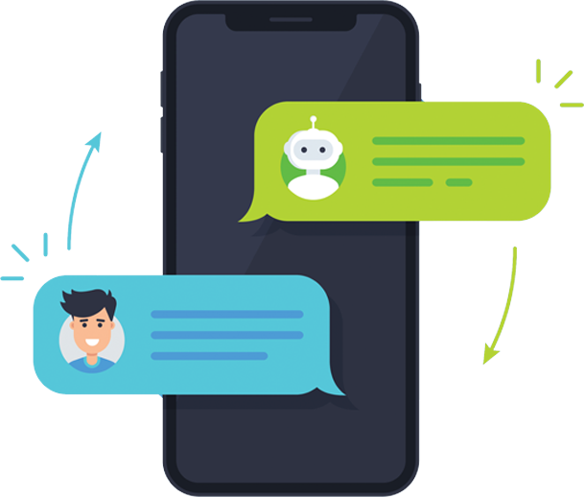
Introduction
What are Conversational Chatbots ?
Conversational Chatbots are AI-powered virtual agents that provide a more human-like experience. In opposition to rules-based chatbots, they are capable of:
Carrying on a natural conversation.
Understanding the meanings of words.
Understanding misspellings.
Continuously improving over time.
Prediction as per the Data Provided.
Because of these important differentiating features, conversational chatbots provide a great user experience through the use of natural language processing (NLP) to understand the context of what a person is saying.

Slide 5
Introduction to Alexios -
Chatbots are the substitute of humans, which communicate using text or voice medium and users obtain reply through AI enabled interface where user can have the sense of interacting with human. Chatbots are utilized in applications like ecommerce customer service, call centres and Internet gaming.
Bots are often programmed to reply an equivalent way whenever, to reply differently to messages containing certain keywords and even to use machine learning to adapt their responses to fit the situation. A developing number of hospitals, nursing homes, and even private centres, presently utilize online Chat bots for human services on their sites. These bots connect with potential patients visiting the hospitals, helping them discover specialists, booking their appointments, and getting them access to the right treatment. An ML(machine learning) model has got to be created wherein we could give any text input and on the ground of training data it must analyse the symptoms. A Supervised Logistic Regression machine learning algorithm can be implemented to train the model with data sets containing various diseases CSV files. The goal is to analyse outputs of numerous models and suggest the most effective model which will be used for symptoms in real-world inputs. Data set contains CSV file having all diseases compiled together. The logistic regression algorithm in ML allows us to process the data efficiently. The goal here is to model the underlying structure or distribution of the data so as to learn more from the training set. This healthcare chat bot system will help healthcare system to provide support online 24 x 7; it answers deep as well as general questions. It also helps to generate leads and automatically delivers the information of leads to sales. By asking the questions in series it helps patients by guiding what exactly he/she is trying to find.

Slide 6
Reason of Selecting the topic -
Availability and ongoing health monitoring.
Providing information fast when there is not a moment to lose.
Gaining the trust of patients.
Scheduling appointments.
Providing support and additional information.

Slide 7

Purpose & Scope
Almost everyone kept on hold while operators connect you to a customer care executive. On an average people spend around 7 minutes until they are assigned to a person. Gone are the frustrating days of waiting in a queue for the next available operative. They are replacing live chat and other forms of slower contact methods such as emails and phone calls. Since chat bots are basically virtual robots they never get tired and continue to obey your command. They will continue to operate every day throughout the year without requiring taking a break.

Slide 8
Methodology
The Health-Care Chat Bot System should be written in Python, GUI links, and a simple, accessible network API. The system must provide a capacity for parallel operation and system design should not introduce scalability issues about the number of surface computers, tablets, or displays connected at any one time. The end system should also allow for seamless recovery, without data loss, from individual device failure. There must be a strong audit chain with all system actions logged. While interfaces are worth noting that this system is likely to conform to what is available. With that in mind, the most adaptable and portable technologies should be used for the implementation. The system has criticality in so far as it is a live system. If the system is down, then customers must not notice or notice that the system recovers quickly (seconds). The system must be reliable enough to run; crash and glitch-free more or less indefinitely, or facilitate error recovery strong enough such that glitches are never revealed to its end-users.

Slide 9
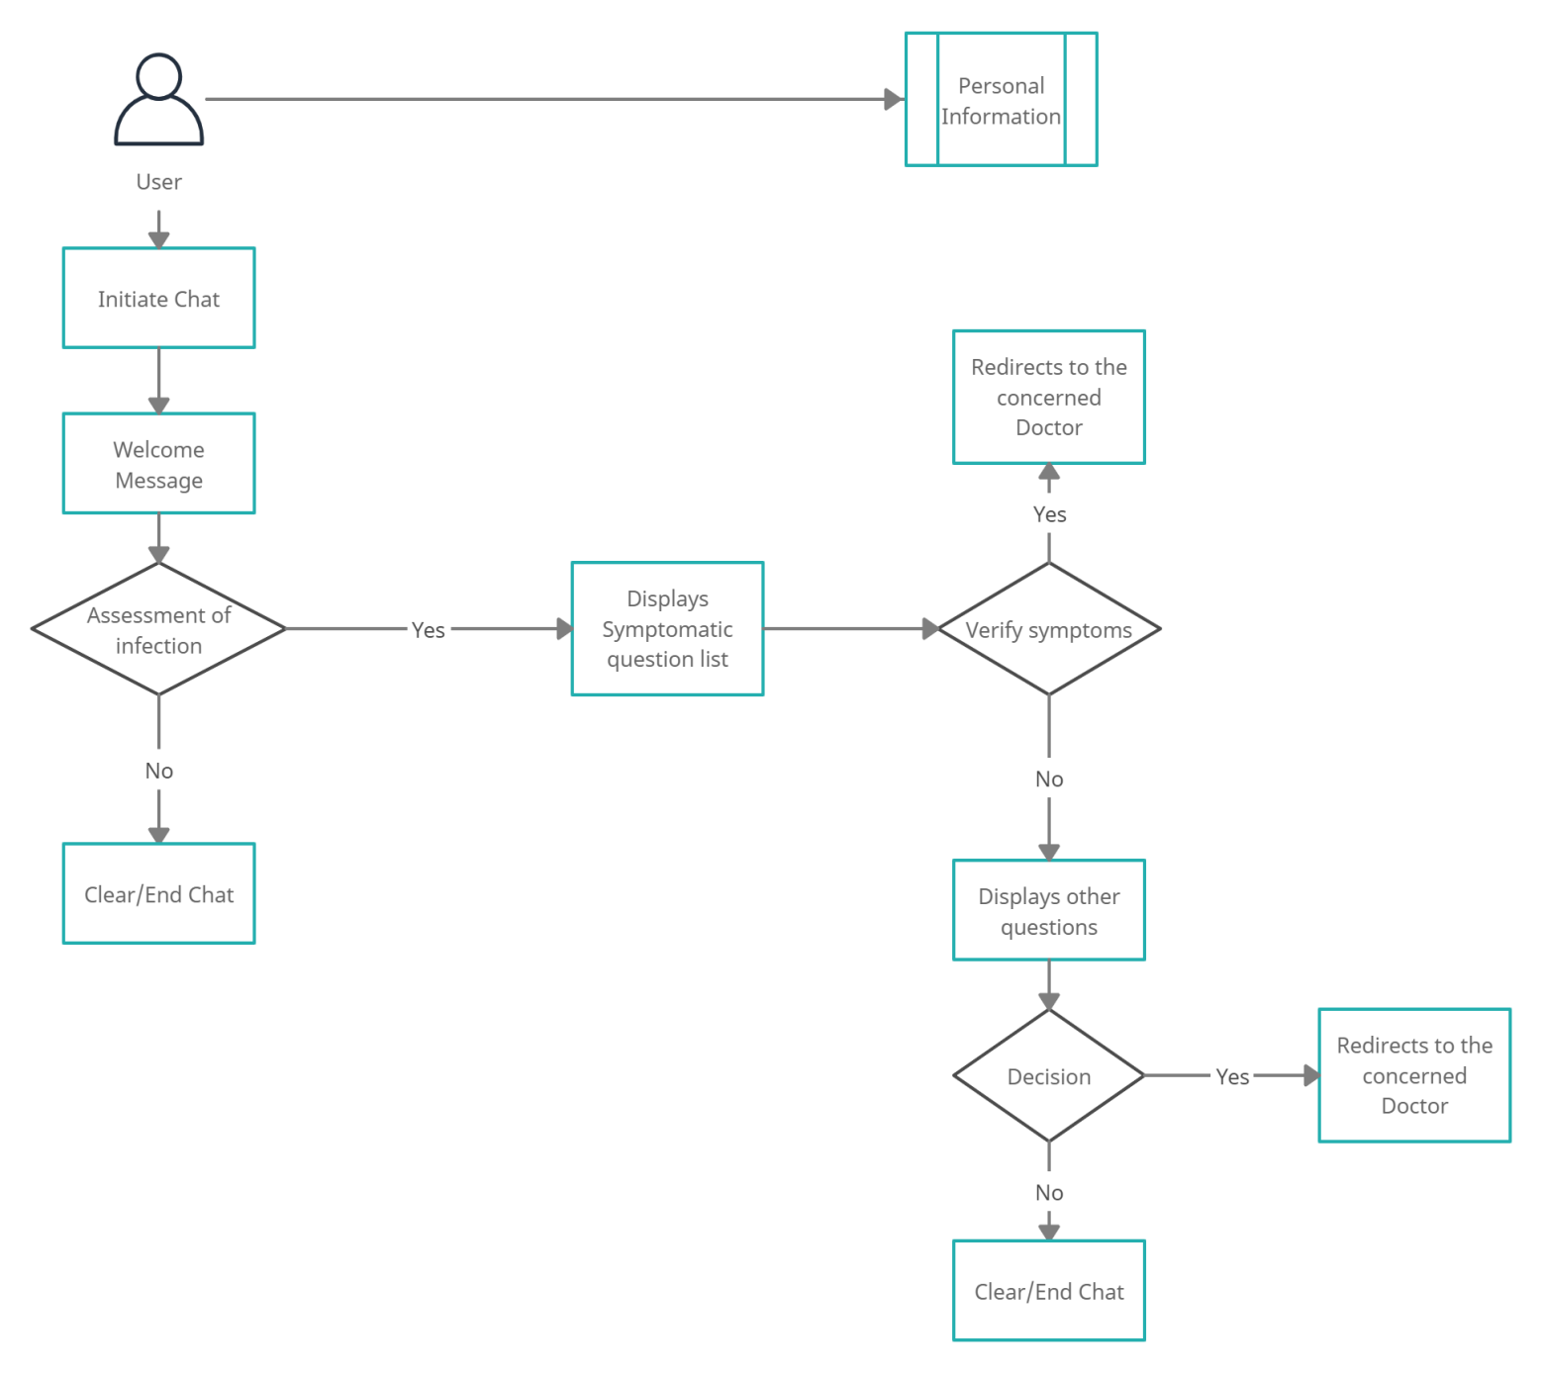
Block-Diagram

Slide 10
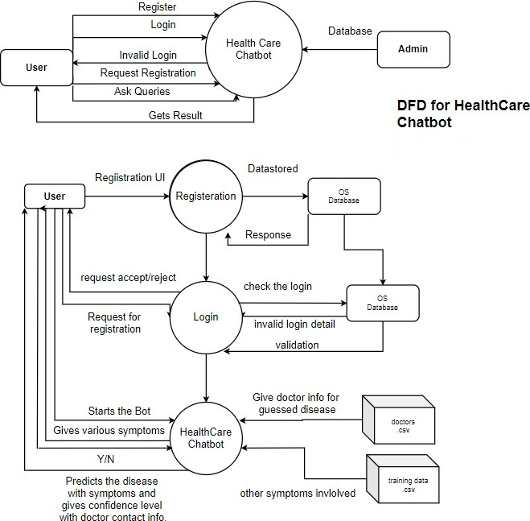
Data Flow Diagram

Slide 11
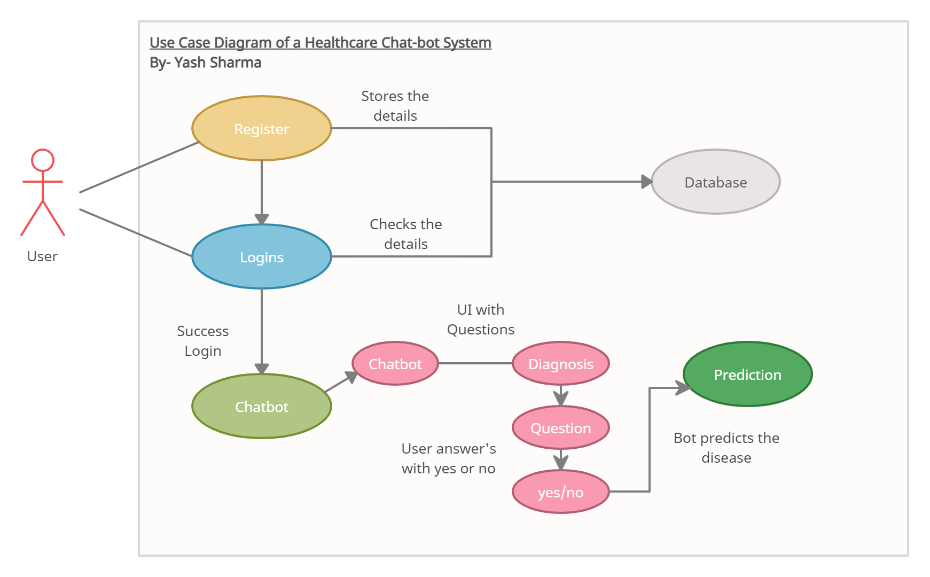
Use Case Diagram

Slide 12
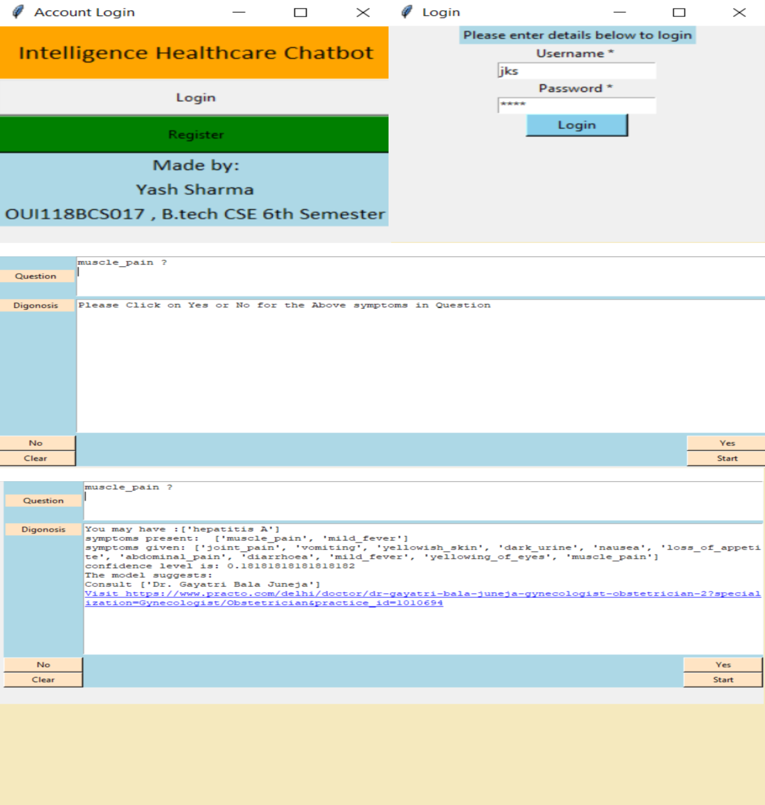
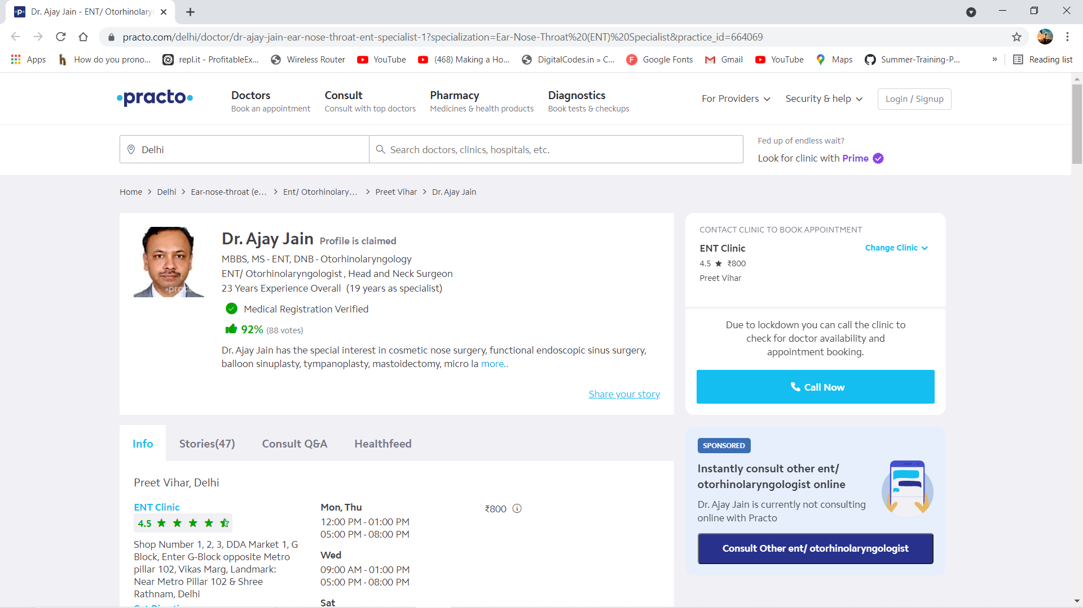
Output (Screenshot)

Slide 13
Analysis of Report
A wide range of positive and negative perspectives was reported on the utilization of health care chatbots, including the importance to patients for managing their health and also the benefits on physical, psychological, and behavioral health outcomes. More consistent agreement occurred about administrative benefits associated with chatbots; many physicians believed that chatbots would be most beneficial for scheduling doctor appointments (78%, 78/100), locating health clinics (76%, 76/100), or providing medication information (71%, 71/100). Conversely, many physicians believed that chatbots cannot effectively care for all of the patients’ needs (76%, 76/100), cannot display human emotion (72%, 72/100), and cannot provide detailed diagnosis and treatment because of not knowing all of the personal factors associated with the patient (71%, 71/100). Many physicians also stated that health care chatbots could be a risk to patients if they self-diagnose too often (714%, 74/100) and do not accurately understand the diagnoses (74%, 74/100).

Slide 14
Conclusion & Future Scope
Conclusion –
Thus, we can conclude that this system is giving accurate results. As I am using a large dataset which will ensure better performance. I build up this system which is useful for people to detect the disease by looking at the symptoms and clicking a yes/no button. This system will not harm any patient as it will first show the question list to the user and as per the question selected by the user, it will just detect the symptoms and refer a doctor to the user with a consultation booking link.
Future Scope -
Chat bots are a thing of the future which is yet to uncover its potential but with its rising popularity and craze among companies, they are bound to stay here for long. Machine learning has changed the way companies were communicating with their customers. With new platforms to build various types of chat bots being introduced, it is of great excitement to witness the growth of a new domain in technology while surpassing the previous threshold.

Slide 15
References

Slide 16
If you picture the journey of Chatbots from the 1960s to now, you can see that what was once a fantasy of being able to communicate with a nonliving virtual being is now part of our everyday lives.

Slide 17

THANK YOU

